Slide 1
Introduction to Survival Analysis
Part #1
Dr Oliver Perra
Full resource, see: https://www.ncrm.ac.uk/resources/online/all/?id=20850

Slide 2
Outline
Type of questions answered by Survival Analysis
Common statistical methods are inadequate
Pre-Requisites for Survival Analysis
Notes:
I will also highlight the pre-requisites for running survival analysis, highlighting the type of information, data and decisions we need to take to ensure we can meaningfully answer research questions using survival analysi.
In this first presentation I will focus on the concepts and principles underlying survival analysis without presenting models and equations, which I will introduce in the other presentations in these resources.

Slide 3
Background
Researchers are often interested in investigating the occurrence of events, e.g.:
  Bio-medical sciences: Onset of puberty;
  Psychology / Psychiatry: First occurrence of suicidal ideation;
  Sociology / Economics: first full-time employment after leaving education.
Notes:
Researchers in very different fields, from economics to medical sciences, from psychology to engineering, are often interested in investigating the occurrence of events, when does a specific event take place?
For example, we may be interested in studying the onset of puberty : when do the physical and hormonal changes that lead to sexual maturity start to appear in a population of young people?
Another example in the field of psychology or Psychiatry involves studying the first instance of thoughts about suicide that individuals experience in their life.
A final example, studying when individuals get a full-time employment after leaving education, if ever.
What do these examples all have in common?

Slide 4
What do these example have in common?
  Bio-medical sciences: onset of puberty;
  Psychology / Psychiatry: first occurrence of suicidal ideation;
  Sociology / Economics: first full-time employment after leaving education.
  Interest in:
    Whether the event takes place;
      When does it take place.
Notes:
Researchers studying these issues are interested in investigating two key questions: whether the event of interest takes place, and when the event takes place.
For example, within a large population, psychiatrists may find that only a relatively small proportion of individuals ever experience suicidal thoughts, so they might be interested in investigating the factors that are associated with the occurrence of this event. Within those that experience suicidal thoughts there may be variability in the onset of these thoughts. Some people may experience suicidal thoughts for the first time in adolescence. Others may experience these thoughts for the first time at an advanced age. There might be differences in the timing of first ever suicidal thoughts between gender, or there might be other characteristics significantly associated with an earlier onset of first ever suicidal thoughts.
The point is that across different disciplines we are interested in studying whether an event took place, and if it did take place, when did it take place? After these two key questions, we may also start asking more specific questions, for example, are women more likely to display an earlier onset of suicidal thoughts than men?

Slide 5
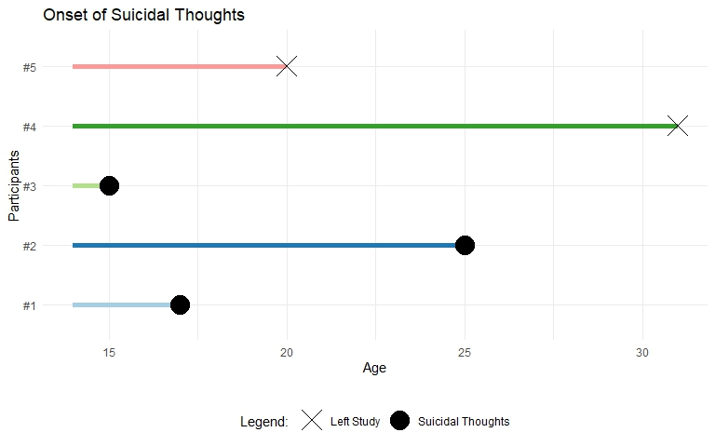
Investigate whether and when questions
  Common statistical methods are inadequate:
Notes:
How to investigate whether and when questions?
Common statistical methods in use are inadequate to deal with these types of data.
Let’s look at this fictional example I have created. The topic is whether and when participants first experienced suicidal thoughts. There are 5 participants, all of them enrolled in the study when aged 14 years.
Participants 1, 2, and 3 all experienced suicidal thoughts, participant #3 at an earlier age of 14, participant #2 when aged 25 years. But we have two more participants who never experienced suicidal thoughts while they were in the study. The problem, which is not uncommon, is that participant #5 left the study at age 20, while participant #4 left the study at age 31.
So, if for example we wanted to report some simple central tendencies statistics to indicate what is the average age of onset of suicidal thought in this sample, how shall we do it?

Slide 6
Investigate whether and when questions
  Common statistical methods are inadequate:
Notes:
We could consider only those that did experience suicidal thoughts: among them, the average age of the onset would be 19 years. But this is discarding information from the other participants that never experienced suicidal thought, so that is not adequate.
We could come up with some arbitrary rule that says where we assume that the participants that left the study experienced suicidal thought after they left the study, so 32 and 21 years for participants #4 and #5 respectively: in this scenario the average age of onset of suicidal thoughts would be 22 years. But these assumptions are just not tenable: many people never experience suicidal thoughts in their life.
We can do better than this!

Slide 7
Survival Analysis
Set of statistical methods to investigate events occurrence and their timing:
  Study Designs: Experimental; Longitudinal (prospective; retrospective)
  Events: Only takes place once; Recurring;
  The main requirements are interest in:
    Whether the target event takes place;
    When does it take place.
Notes:
Survival analysis is a set of statistical methods that provides answers to research questions that concern whether and when events take place.
These methods are quite flexible.
They can be applied to different studies design, such as experimental studies or RCTs, Longitudinal studies, whether data are collected prospectively or retrospectively.
They can be applied to events that only happen once, e.g. puberty onset, or are recurring, e.g. suicidal thoughts.
Furthermore, survival analysis can be applied to “negative” events like death, onset of disease, relapse, but can equally be applied to “positive” events, for example promotions at work, the timing of an infants’ first words, etc.
The survival analysis label is there because the method was developed to investigate the timing of death of patients with different conditions. However, these methods can effectively be applied to different topics, the main requirements are that the research questions concern whether and when a target evnt takes place.
In the remainder of this presentation, I will illustrate pre-requisites that need to be satisfied if we are to use survival analysis.

Slide 8
Survival Analysis: Pre-requisite #1
A clearly defined target event:
  A transition from one state to another state:
    E.g.: Never thought about suicide (state 1) vs. Ever thought about suicide (state 2).
  Mutually exclusive and exhaustive states.
Target events can :
  Be dichotomous (never vs. ever suicidal thoughts); Have more categories (e.g.: employed, unemployed, self-employed, retired);
  Take place once; Take place several times (recurring).
Notes:
Firstly, survival analysis necessitates a clearly defined target event.
This means that the target event should be defined as a transition from one state to another state.
In the example before, individuals were in one state if they never had any thought about suicide, but transition a second state as soon as they think about suicide for the first time.
Another example is ever been married: people that have never married are in state 1 until they marry, and thus move into state 2.
From these examples it will appear clear that the states that make up the target event should be mutually exclusive and exhaustive.
Which means that no individual can be in more than one state at any given time: an individual either have never had suicidal thoughts, or had experienced suicidal thoughts. An individual either has been or is married, or has never been married. Exhaustive states means that all the individuals should be in one or another of the possible states. All individuals will have either ever experienced suicidal thoughts, or never experienced them.
Survival analyses are often applied to dichotomous target events where there are only two possible states, dead or alive, never married vs. ever married. However, these methods can be applied to target events that can have more than two states. For example, a person may be employed, self employed, or unemployed. The point is that all these states should be exhaustive, so all individuals should be in one or another of these three categories. And states should be mutually exclusive, an individual will be in only one category at any given time: someone employed cannot be unemployed at the same time.
Also, transitions into one state can take place only once, e.g. the transition from alive to dead is irreversible. But in other cases individuals may transition between states several times. For example, if we were interested in the occurrence of suicidal thoughts over time, rather than their first onset, we may record that some individuals have experienced suicidal thoughts on different occasions. Or, for example, some individuals may move from being unemployed to employed several time. The key point is that at any given time individuals should be in one or another state, and they all should be in one of the event states.

Slide 9
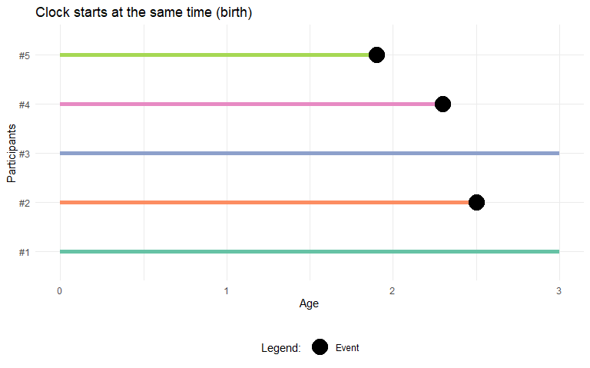
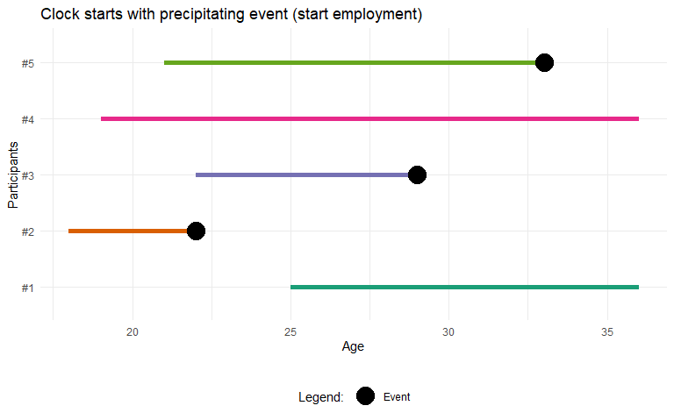
Survival Analysis: Pre-requisite #2
A clearly defined beginning of time:
  A point where all individuals have not yet experienced the target event, but they are susceptible to experiencing it.
  The same for all individuals; Linked to a precipitating event.
Notes:
Another requisite for survival analysis is to identify a point to start the clock in the study, so called “beginning of time”.
In other words, the researchers must identify a point where all the individuals in the population are in the same state of the target event. For example, when we are studying life expectancy in a population, all livebirths start life in one state, being alive, and from that point on, they can transition into the alternative state of being dead. In similar studies, birth is the “beginning of time”.
So the, beginning of time is a point where all the individuals in the study have not yet experienced the event, but every individual may potentially be at risk of experiencing it.
In some studies the beginning of time is the same for all participants, in this sense, the clocks starts at the same time. For example, in many studies that consider age as the time variable, birth is the beginning of time when all participants have not yet experienced the event but are eligible to experience it.
In other studies the beginning of time may be linked to a “precipitating event”. For example, if we were interested in whether and when someone is promoted in their job, the beginning of time may be the time when individuals start in their job. This will be different across participants, in this fictional example, #2 started their job at 18 years, #1 started at 25 years. The time variable in this study is not age, but rather time in employment.
In many studies the start time may be arbitrary or dictated by convenience. This is fine, but it is important to that the starting time must be unrelated to event occurrence.

Slide 10
Survival Analysis: Pre-requisite #3
A metric for time:
  Record time in the smallest possible units relevant to the event of interest.
  Two main types:
  Continuous time Discrete time
Notes:
It is then important to specify a metric of time: what are the units that researchers will use to record the passing of time?
Many events of interest can be recorded using a very precise time measurement. For example, if we conducted a diary study of suicidal thoughts and asked participants to record the onset of a suicidal thought using an app, we could potentially record the occurrence of these thoughts in minutes. Another example: using death certificates epidemiologists can record lifetime in days.
However, there are often limits to the precision of the time measurement due to practical problems. Some of these problems may be linked with the way data are recorded when researchers use administrative data or data collected by others. For example, hospital records may record the occurrence of some interventions in weeks, rather than in days. Other limitations may be due to the nature of the events researchers are interested in. For example, if we are interested in the timing of academic promotions, promotions are awarded yearly. Other limitations may be due to the study design: when we collect data retrospectively and ask participants to recall when a specific event took place, unless it was a very salient event, participants may recall the month, the season, or just the year an event took place.
The main point is that time should be recorded in the smallest possible unit that is relevant to the event of interest. For example, when we study the timing of a child’s first words, measuring this in years would be a very coarse measure: it will not be very useful to know that most children say their first words in their 2nd year, rather than in their 1st one. Recording the first words in months is more adequate.
So, there are two main types of time measurements, continuous, as when we can measure lifetime in days, or discrete, as when we measure onset of suicidal thoughts in years.

Slide 11
Survival Analysis: Pre-requisite #3
A metric for time:
  Record time in the smallest possible units relevant to the event of interest.
  Two main types:
  Continuous time Discrete time
Tie
Ties
Notes:
This distinction is important for a further reason. When we measure time continuously, the probability of two individuals experiencing the target event at the same time will be low. Here, the red dots represent the timing of the target event for different participants.
When two individuals experience the target event at the same time, this is called a tie. When we measure time continuously, ties are less likely and we will observe few of them.
When time is measured in discrete and more coarse units, ties will be inevitable.
This is important because more modern methods in survival analysis, such as Cox regression (aka Proportional Hazard Modelling) assume that time is recorded continuously, and therefore ties should be far and few between. Applying these methods to data that have many ties means stretching the models to a point where their inference may be unreliable.

Slide 12
Summary
Survival Analysis: statistical method to answer questions concerning whether and when an event takes place
  Prerequisites:
    #1 Define event occurrence: transition from state 1 to state 2
    #2 Identify “beginning of time”: starting point of study should not be related to the target event occurrence
    #3 Specify time metric: smallest possible unit relevant to the event of interest

Slide 13
www.ncrm.ac.uk

